Slide 1
Informational Briefing on Upstream & Midstream Natural Gas Industry
Jim Welty, President
Marcellus Shale Coalition
June 9, 2025

Slide 2
About the MSC
Our Membership
Over 145 diverse members
Upstream, midstream, downstream and industry partners
Our Focus
Pennsylvania’s leading advocate for natural gas development
Developing end-use opportunities
Achieving environmental excellence
Addressing stakeholder issues
Fostering professional development opportunities
Maximizing benefits to ensure the region’s secure energy future
Associate Members are an integral part of the MSC and the industry's robust supply chain.
More than 95% of the natural gas in
PA is produced, processed and transported by MSC member companies.
The MSC Board of Directors consists of major upstream, midstream and downstream
companies in the
Appalachian Basin.

Slide 3
What is Marcellus shale?

Slide 4
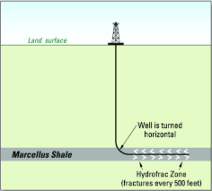
What is Marcellus Shale?
Layer of sedimentary rock situated a mile or more below the surface
Generally, 50 feet – 300 feet thick
“Source” rock from which gas pockets or reservoirs above originate
Marcellus is most common formation, but there are others (Utica)
Name derived from locations where there are outcroppings:
Marcellus, New York
Utica, New York
Source: Researchgate.net

Slide 5
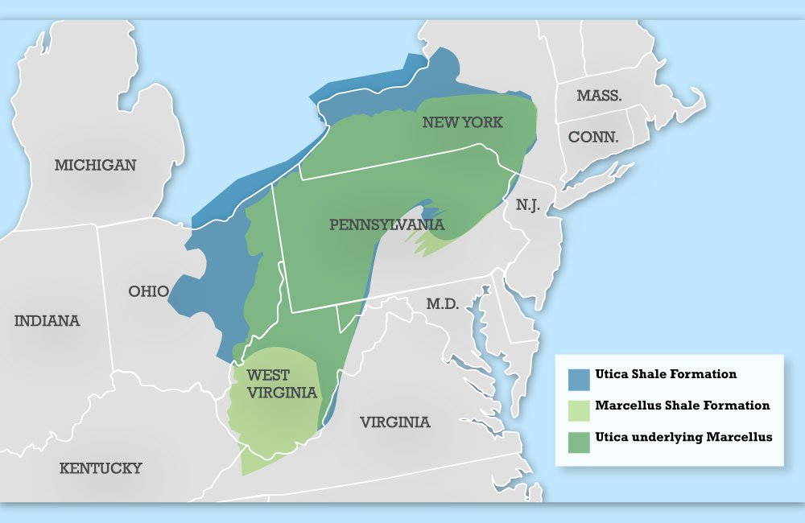
Shale Gas in PA

Slide 6
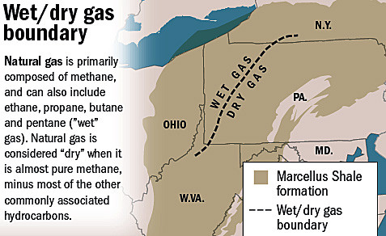
Shale Gas in PA
Source: Penn State University Extension

Slide 7
Drilling and Production Process

Slide 8
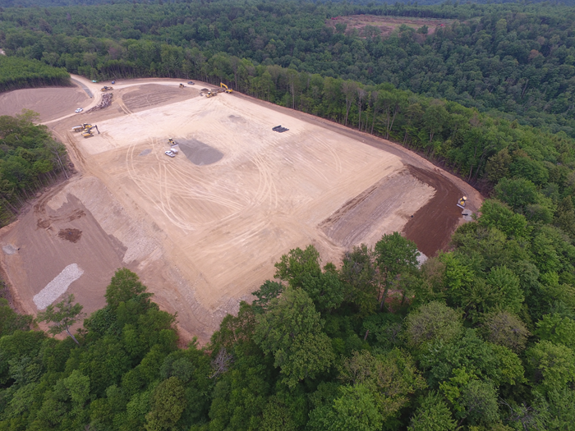
Pad Construction
Multiple-acre pad constructed to accommodate numerous wells
Horizontal drilling of multiple wells greatly reduce surface disturbance
Spill containment engineered into pads

Slide 9
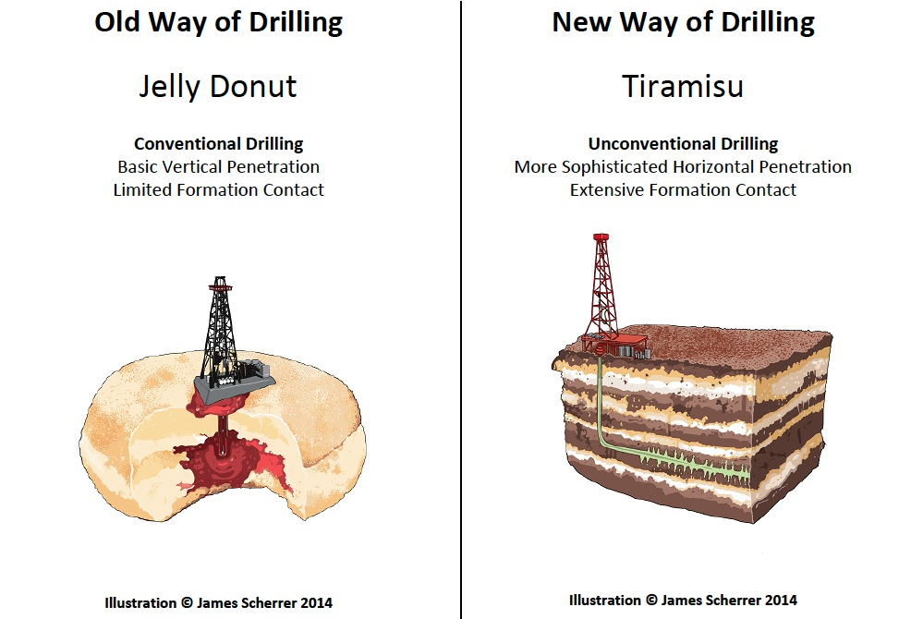
Drilling
Top hole drilling followed by deep drilling
Freshwater: 200’ - 500’
Marcellus Shale depth: 3000’ - 10,000’
Utica Shale depth: 7,000’ - 15,000’

Slide 10
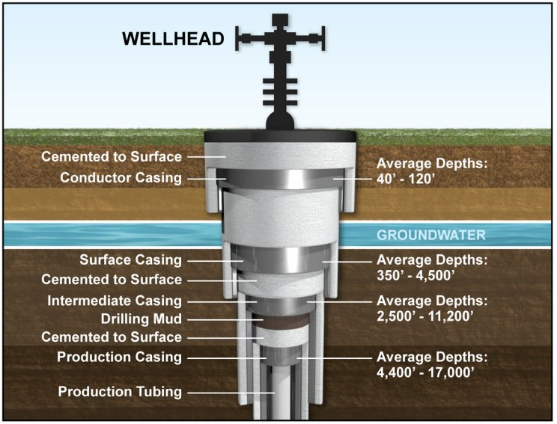
Drilling
Multiple layers of casing and specialized cement protect groundwater and stabilize the well
Conductor casing: ~ 40’ - 100’
Surface casing: ~350’
Intermediate casing: ~ 2500’
Production casing: to end of lateral

Slide 11
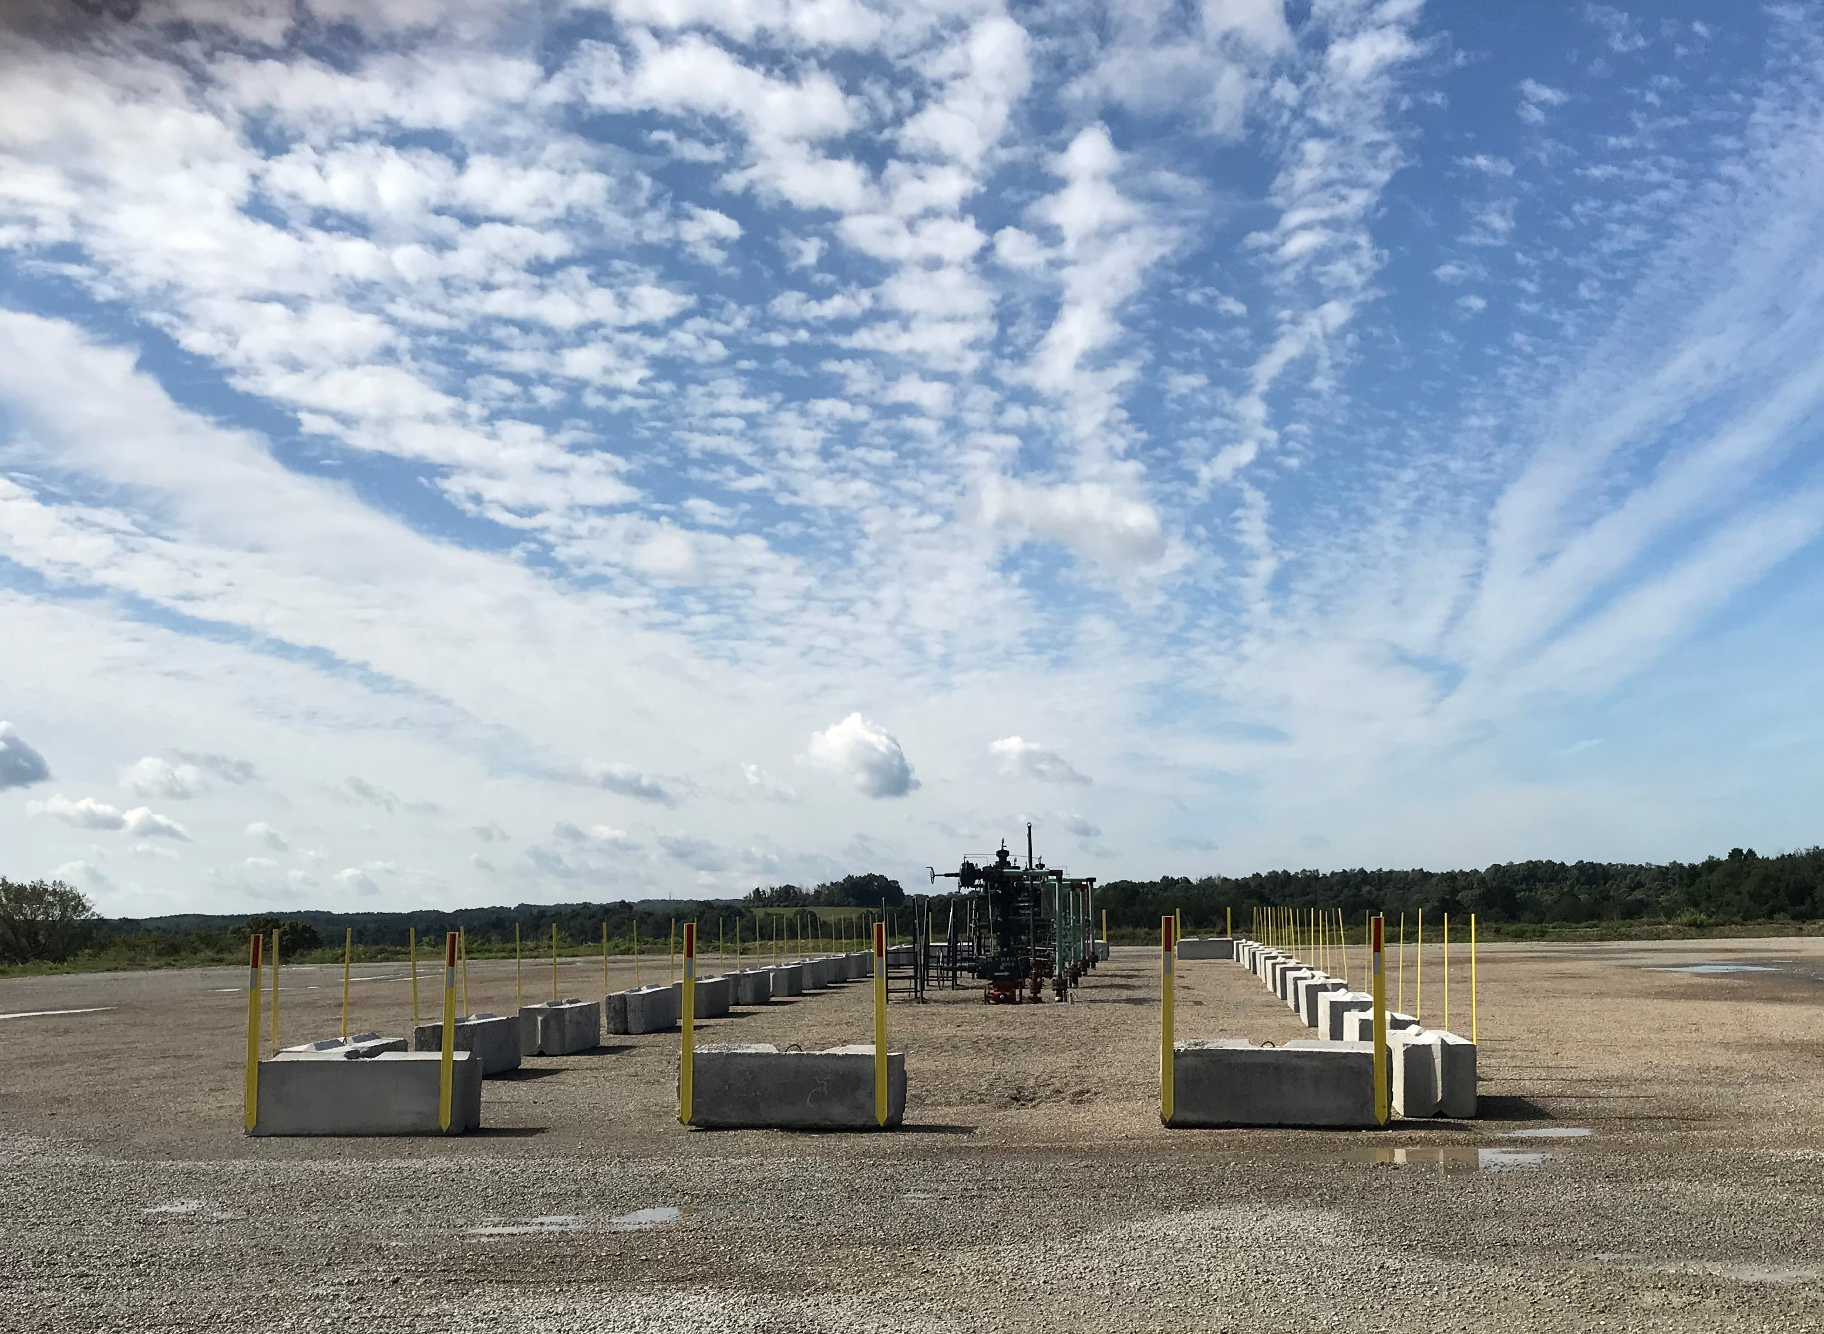
Production and Restoration
Wells connected to gathering lines which typically take gas to transmission pipelines
Installation of production equipment on pad including water tanks and meters
Well produces gas, which is gathered and delivered by underground pipe to processing facility & transmission line
Pad site shrunk; most equipment removed; surrounding land restored to contour and landscaped/seeded
Washington County, PA

Slide 12
Midstream: Gathering and Processing

Slide 13
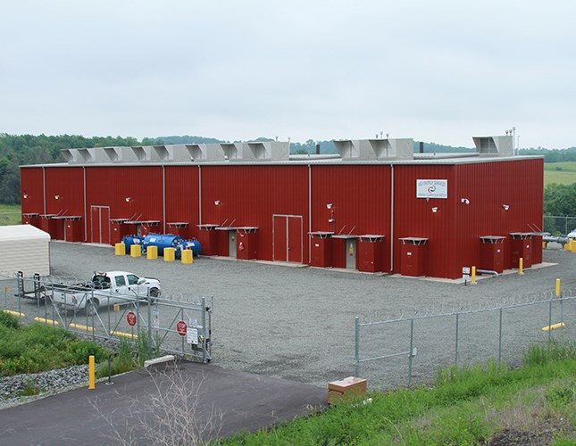
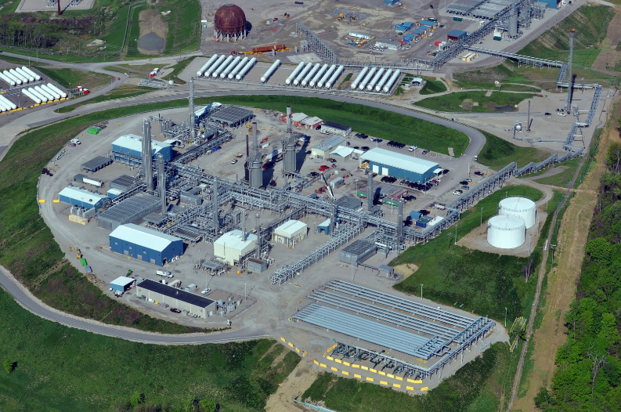
Gathering and Processing
Underground pipelines collecting gas & transporting to compressor/processing plant
Separation of natural gas liquids, dehydration, and compression
Connects with large-diameter interstate transmission pipelines for delivery to end-user (utilities, power plants, etc.)

Slide 14
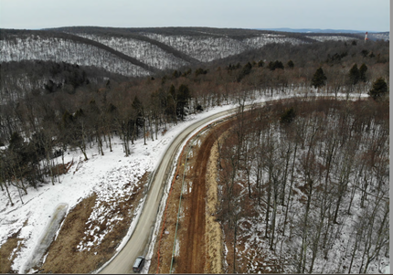
Pipeline Construction: Before and After
Active Construction – Cogan House Twp., Lycoming County
In-Service Gathering Line
Loyalsock Twp., Lycoming County

Slide 15
Current Drilling and Production Activity in PA

Slide 16
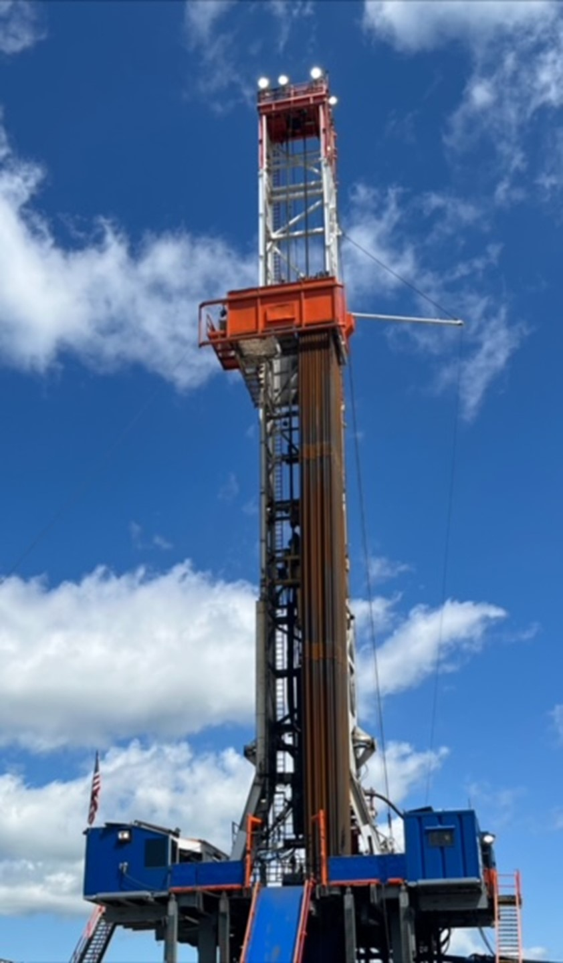
PA By the Numbers
2nd largest natural gas producer in U.S.
18% of total U.S. natural gas production*
Number of wells*:
11,887 in production
33 of 67 counties with at least 1 producing well
NC/NE 53.9% SW 43.5% NW 2.6%
17 active rigs (June ‘25)
* As of February 28, 2025
Tioga County, PA

Slide 17
PA By the Numbers

Slide 18
PA By the Numbers
Top Ten Producing Counties
by Volume (2024)
County | Production (MCF) | % of PA Production | # of Producing Wells
Susquehanna | 1,404,527,885 | 18.67% | 1,936
Greene | 1,149,350,374 | 15.3% | 1,452
Bradford | 1,131,149,998 | 15% | 1,458
Washington | 1,100,112,241 | 14.6% | 1,898
Lycoming | 519,812,079 | 6.9% | 981
Tioga | 432,852,334 | 5.8% | 846
Westmoreland | 297,914,107 | 4% | 337
Butler | 287,297,287 | 3.8% | 609
Wyoming | 234,410,019 | 3.1% | 320
Allegheny | 167,888,189 | 2.2% | 181

Slide 19
Natural Gas Utilization

Slide 20
Natural Gas Utilization
Electric Power Generation
60% of PA’s electricity comes from natural gas (up from 5% in 2005)
Approximately 12% of natural gas used in PA goes to electric power generation in PA
Home and Commercial Heating
Approximately 55% of PA homes and commercial buildings heat with natural gas or propane
Consumer Products
Natural gas liquids (e.g. ethane) are foundation building blocks for nearly all chemicals and consumer products

Slide 21
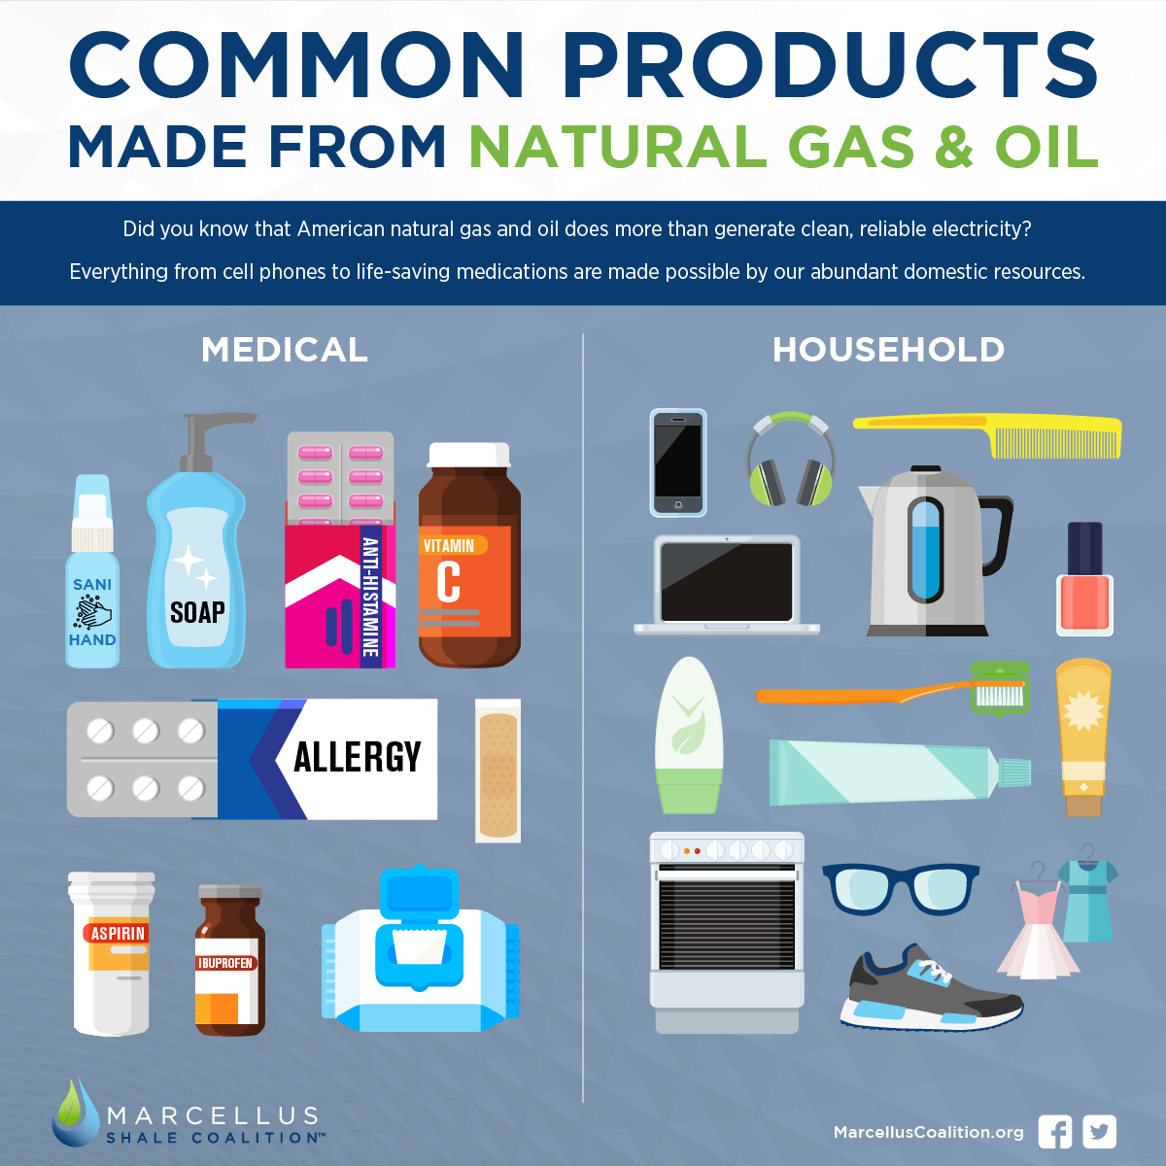
Natural Gas Liquids: Feedstock of Our Economy

Slide 22
CONSUMER & ECONOMIC BENEFITS

Slide 23
Economic Impacts
PA’s natural gas industry:
Supports 123,000 jobs in Pennsylvania
Generates more than $41 B in economic activity
Pays over $6.3 B in royalties to PA landowners
Pays workers an average of $97,000
Contributes over $5.8 B in local, state & federal taxes

Slide 24
Lower Prices = Customer Savings
2008 vs 2024
Utility | PGC Rate / MCF |  | % Change | Annual Customer Savings**
 | 2008* | 2024* | 2008-2024 | Residential | Commercial | Industrial
PECO | $13.16 | $4.86 | -63% | $564 | $3,860 | $25,938
NFG | $10.86 | $3.13 | -71% | $673 | $1,933 | $11,773
PGW | $13.02 | $3.34 | -74% | $590 | $3,243 | $9,680
Columbia | $15.94 | $4.82 | -70% | $767 | $3,314 | $41,767
UGI | $13.26 | $4.53 | -66% | $629 | $2,750 | $10,895
Peoples/Equitable | $15.89 | $3.37 | -79% | $977 | $3,230 | $39,438
* PUC Purchased Gas Cost (PGC) Rate in Effect Prior to Annual Review
** Based on average customer usage for each utility as reported in PA PUC Natural Gas Outlook 2024

Slide 25
Benefiting Consumers
$9,956,555,484
PA Natural Gas Consumer Savings in 2024 compared to 2008 prices
Based on average customer usage for each PA utility as reported in PA PUC Natural Gas Outlook 2024. Savings adjusted to reflect inflation 2008-2024 (Bureau of Labor Statistics)

Slide 26
ENVIRONMENTAL BENEFITS

Slide 27
PA’s Changing Energy Landscape
60%
0.4%
Source: U.S. Energy Information Administration – Electricity Data Browser

Slide 28
Leading on Climate Change
Source: U.S. Energy Information Administration; PA IFO

Slide 29
Enhancing Air Quality
Source: PA Department of Environmental Protection – Air Emission Report (Power BI) – Accessed February 2025

Slide 30
Enhancing the Environment…Enhances Public Health
Since 2005
These emission reductions equate to public health benefits of between $491 Billion - $1.13 Trillion for Pennsylvania residents.

Slide 31
Thank you!
Jim Welty, President
jwelty@marcelluscoalition.org
Patrick Henderson, Vice President,
Government Affairs and Communications
phenderson@marcelluscoalition.org

