Slide 1
Marcellus Shale – Managing Our Road System
Marcellus Transportation Safety Day
September 22, 2011
Deputy Secretary for Highway Administration
Scott Christie, P.E.

Slide 2
PennDOT Roadway Management Responsibilities
Maintaining 40,000+ Miles of Roadway
Maintaining 25,000+ Bridges
11,215 Miles of Roadway Posted Statewide
4,068 Miles of Roadway Posted Since 2008 (Primarily related to Marcellus Shale Activities)
Notes:
Data on posted roads as of 9/12/11.

Slide 3
PennDOT’s Intent
No Deterioration of Existing Roads
No Deterioration of Existing Bridges
Recover all Associated Costs
Permits (Be Helpful)
Bradford County – 4/23/2010

Slide 4
Marcellus Miles Surveyed

Slide 5
Roadway Damage – Posted and Bonded Roads Statewide
Districts | Posted Data |  | Damage Data |  | Repair Data
 | Total Posted Miles | Marcellus Posted Miles (‘08-’11) | Minor Damage Miles | Major Damage Miles | Miles Under Repair/ Scheduled | Miles Not Under Repair/Not Scheduled
1 | 1,775 | 542 | 0 | 0 | -- | --
2 | 1,278 | 510 | 225 | 0 | 0 | 225
3 | 1,632 | 1,513 | 416 | 2 | 19 | 399
4 | 1,377 | 1,108 | 83 | 0 | 0 | 83
9 | 1,172 | 63 | 17 | 0 | 0 | 17
10 | 1,927 | 22 | 93 | 0 | 12 | 81
11 | 435 | 19 | 0 | 0 | 0 | 0
12 | 1,589 | 290 | 185 | 12 | 0 | 197
Totals | 11,185* | 4,068 | 1,019 | 14 | 31 | 1002
Data as of 09.12.2011 * Does not include Districts 5 and 6
Notes:
11,215 Total Posted Miles Statewide (All Districts); Districts affected by Marcellus shown.
Non-Marcellus Districts (5 and 6) not included in chart.
Started and Scheduled Repairs Combined.

Slide 6
Miles of Significant Marcellus Damage

Slide 7
Miles of Minor Marcellus Damage

Slide 8
Roadway Impacts – Minor Damage
Base Failure
Edge deterioration

Slide 9
Roadway Impacts – Minor Damage
Pot holes
Edge deterioration

Slide 10
Permit Application Review Process
How is PennDOT performing?
Goals:
Expedite all permits so there are no delays in work
Permit issuance cycle time < 30 days (all permits)
No more than 2 application review cycles

Slide 11
Permit Types
Overweight (posted highways)
Driveway
Utility
Seismic/Other Testing
APRAS
Oversize/Overweight
Superloads
Bridge (not covered)

Slide 12
Permit Types – Overweight
Required for Hauling on a Roadway Posted for Weight Restrictions (Typically Over 10 Ton)
Requires Entering into An Excess Maintenance Agreement (EMA) with the Department
Security required
Recent changes to the EMA allow more expedient permit process

Slide 13
Permit Types - Overweight
Permit Type | # of Trucks | # of Travel Routes
Type 1 | 1 User | 1 Travel Route
Type 2 (Most Heavy Users) | Multiple Trucks (1 User) | 1 Travel Route
Type 3 | 1 User | Multiple Routes

Slide 14
Permit Types - Overweight
How Has Performance Improved Through Changes to EMA?
Form approval has reduced agreement execution time from >45 days to 1 – 2 weeks.
SRs can be added/subtracted at District level
Security can be added/subtracted at District level
Bottom line → Faster Turnaround On Issuing Permits

Slide 15
Permit Types – Highway Occupancy
Includes Permits for…
High, Medium and Low Volume Driveways
Minimum Use Driveways
Temporary Access
Local Road
Alterations to Existing Driveways
Utility
Testing – Seismic/Other

Slide 16
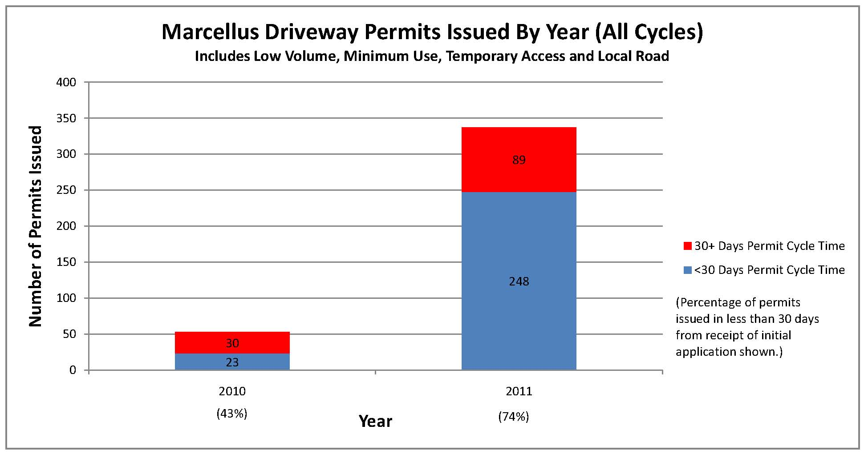
Permit Types – Highway Occupancy
Improvement in Performance:
Notes:
For Marcellus Shale permits the goal is to approve within 30 days of initial receipt of application. Goal includes all cycles.

Slide 17
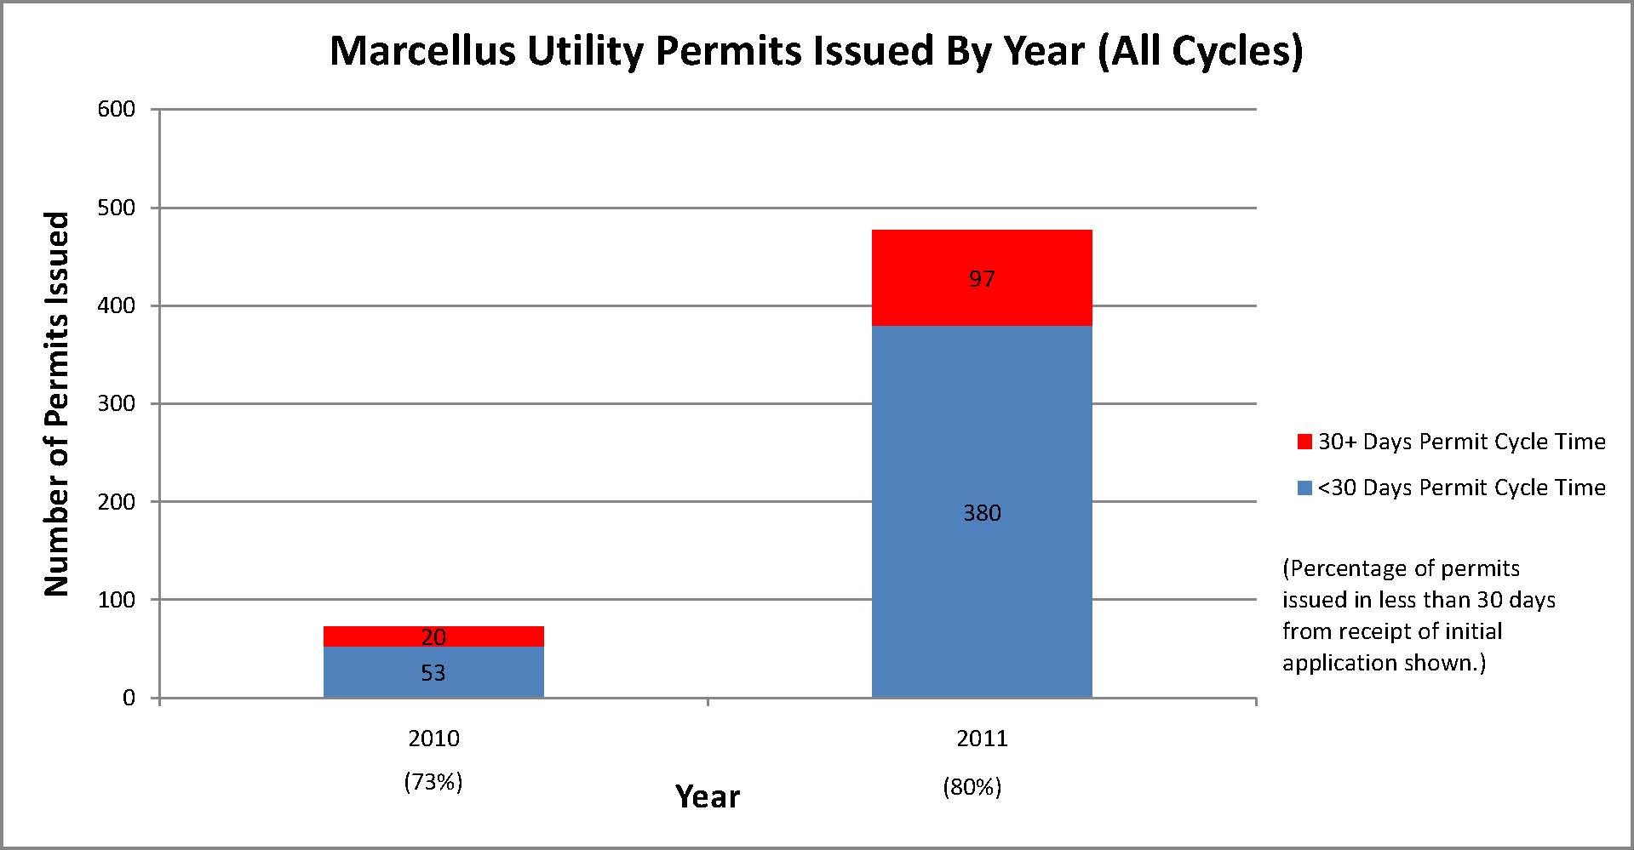
Permit Types – Highway Occupancy
Improvement in Performance:
Notes:
For Marcellus Shale permits the goal is to approve within 30 days of initial receipt of application. Goal includes all cycles.

Slide 18
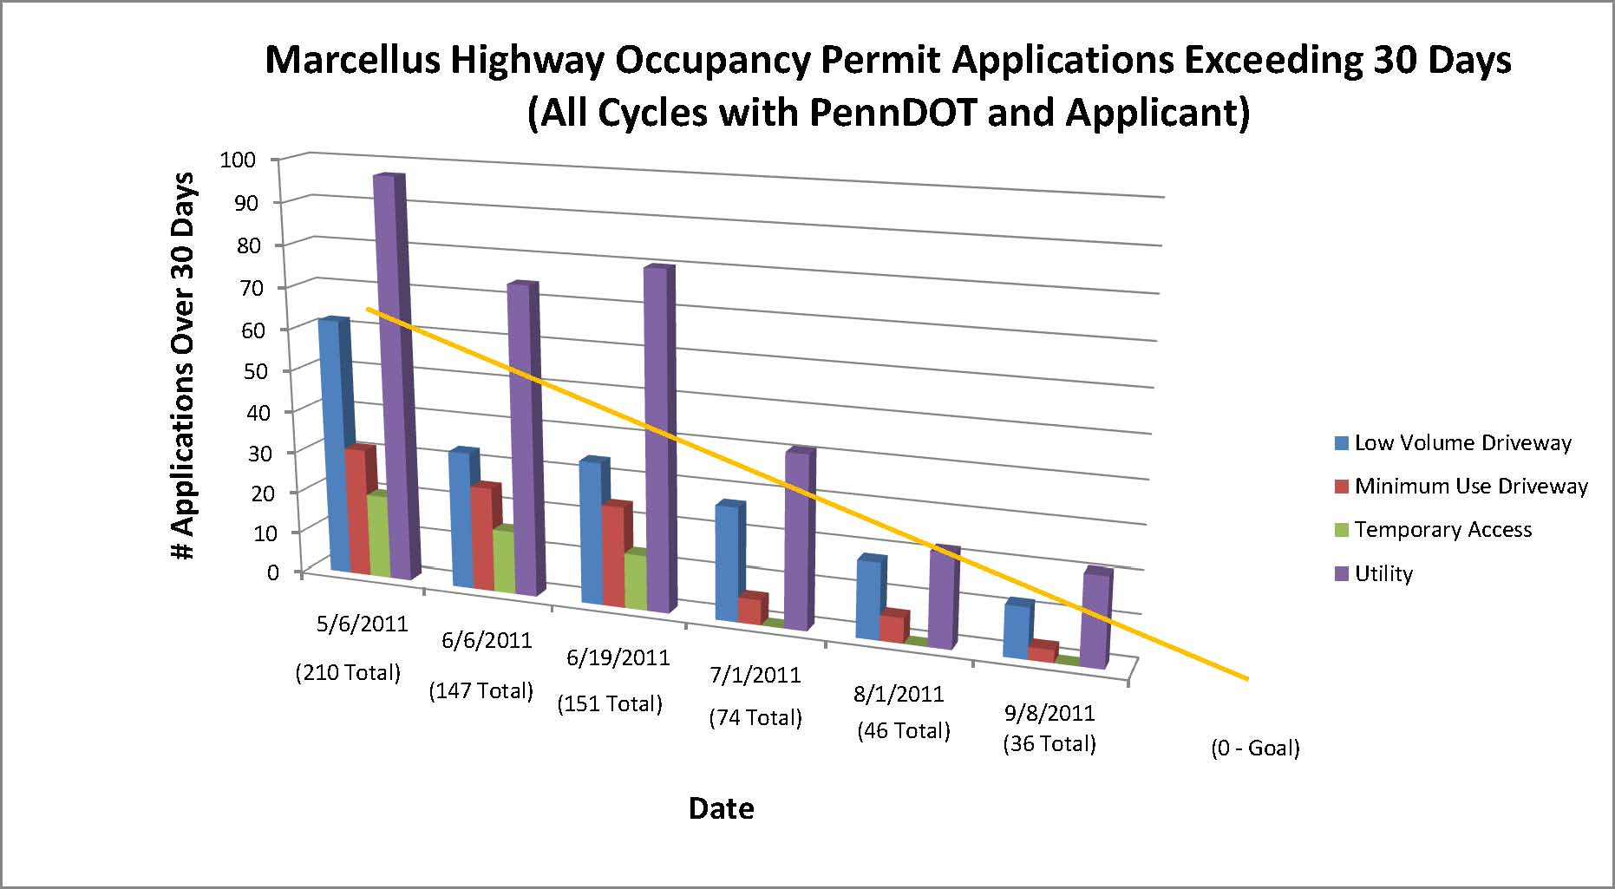
Permit Types – Highway Occupancy
Improvement in Performance:

Slide 19
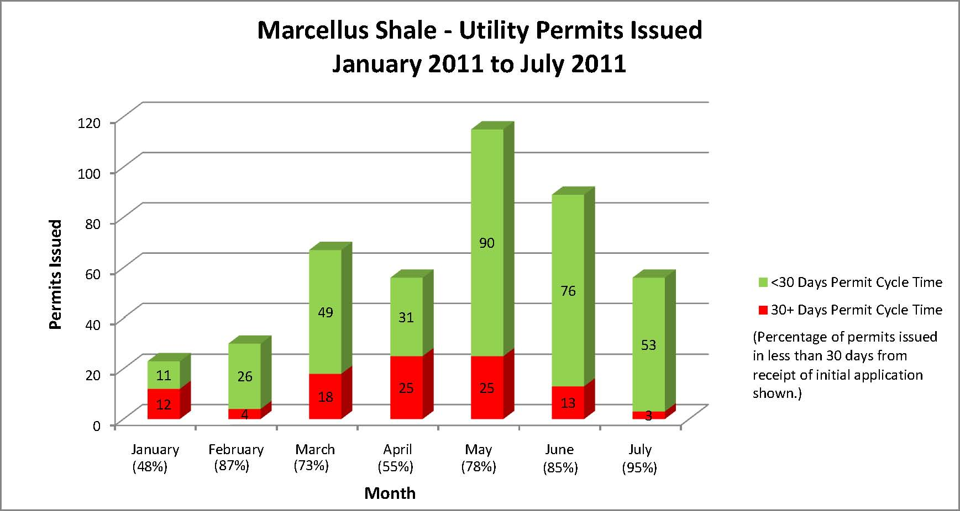
Permit Types – Highway Occupancy (Utility)
Improvement in Performance:

Slide 20
Permit Types – Highway Occupancy
Future Improvements:
- e-Permitting to go online 10/2011
Submit applications via ePermitting website
Follow progress of application thru Dept. review process
View Dept. comments & submit revisions electronically
Retrieve permits thru ePermitting system
Reduce total amount of time to receive permit

Slide 21
Permit Types - APRAS
APRAS – Automated Permit Routing/Analysis System
Required for Oversize/Overweight and Superloads
Permit Issued within minutes (if no manual review)
If manual review; typical turnaround 2.5 hours
Drastic increase in manual reviews with increase in heavy hauling

Slide 22
APRAS Permit
Oversize/Overweight
Over legal Limit (40 Ton)
Under superload
Not divisible
Notes:
Oversize/Overweight Definition:
Over 80,000#
Under 13’6” High
Less than 8 ft wide
8’6” for National Network and STAA approved routes

Slide 23
APRAS Permit
Superload
Two step process
Preliminary permit (plan on three weeks prior to move)
Final permit (submit five days prior to move)
Permits reviewed in order received
Accuracy matters!
Coordinated thru the Central office
Requires a State police escort
PSP requires 48 hours notice
Notes:
Superload Definition:
Gross Weight exceeding 201,000
Total Length exceeding 160 feet
Total width exceeding 16 feet

Slide 24
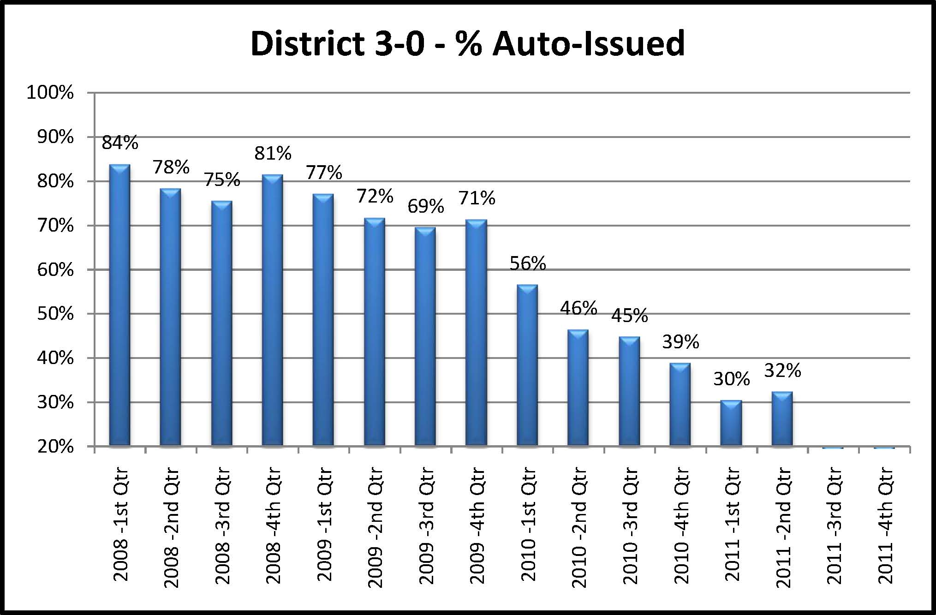
APRAS Performance
Volume of permits have increased drastically since 2009.
Percentage auto-issued has dropped as a result of the increase in volume.

Slide 25
APRAS Performance
Notes:
Data through August 2011.
Average time for all automated and manual reviews.

Slide 26
Thank You

